Slide 1
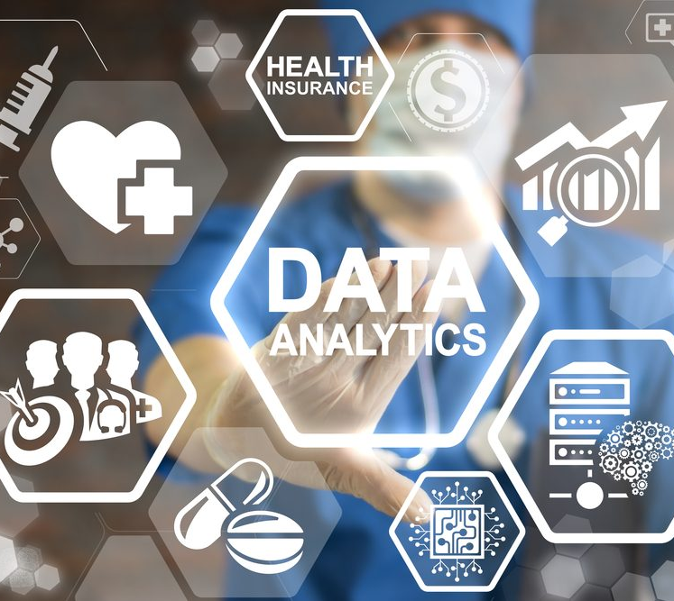

Data science and data analytics healthcare market trends
Production project
Presented By :- Hritick Jha(77356744)
Supervisor By :- Shiva prasad Nepal

Slide 2
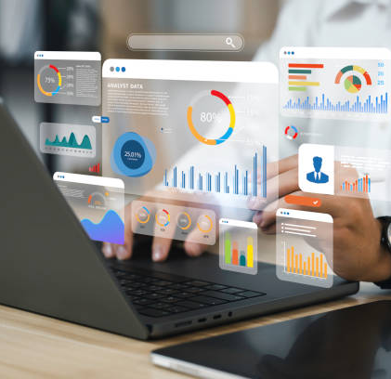
Introduction of the project
This project applies data science to analyze and forecast healthcare market trends.
It features an interactive dashboard and predictive model for strategic planning.
Python, Power BI, Excel, and Jupyter Notebook were used for data analysis and visualization.
The solution enhances decision-making with secure, scalable, real-time Web application.

Slide 3
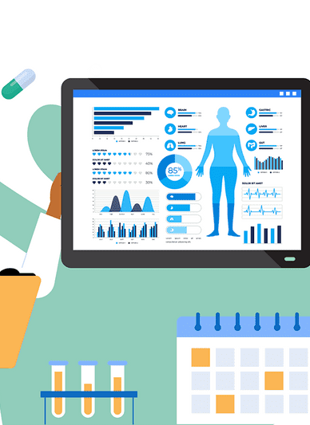
Objective of the Project
To analyze and forecast healthcare market trends using data science and predictive analytics.
To develop an interactive dashboard for real-time data visualization and decision support.
To enhance healthcare resource allocation, marketing strategies, and stakeholder insights.

Slide 4
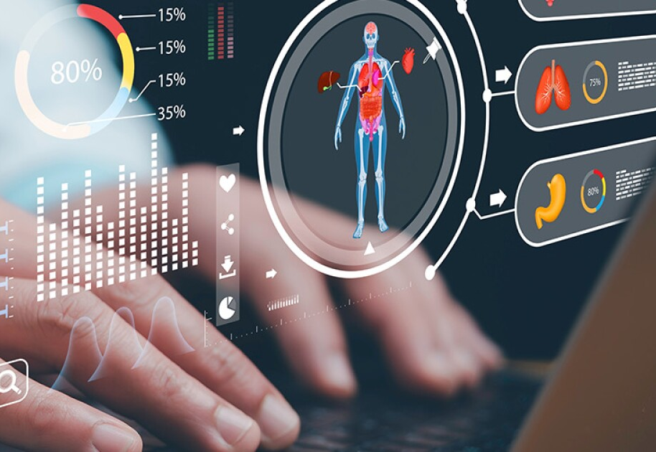
Project Scope
Focuses on applying data science techniques to healthcare data for market trend analysis and prediction.
Involves developing a web-based interactive dashboard with cloud integration for real-time access.
Covers data collection, preprocessing, modeling, visualization, and system deployment using modern tools.

Slide 5

Problem Statement
Healthcare organizations struggle to make data-driven decisions due to fragmented and unstructured data.
Lack of real-time analytics limits the ability to forecast trends and allocate resources effectively.
There is a need for a scalable, secure solution to visualize and analyze healthcare market data efficiently.

Slide 6


Methodology
The project follows an Agile development approach with iterative design and feedback cycles.
Data was collected from various sources, cleaned, and analyzed using Python in Jupyter Notebook.
Exploratory Data Analysis (EDA) guided model development and feature selection.
Visualization and dashboard creation were done using Power BI for real-time insights and usability.

Slide 7

Production project Process
Requirement Gathering: Identified system goals, user needs, and technical constraints through research and observation.
Design & Development: Created wireframes, dashboards, and predictive models using Python, Power BI, and Figma.
Implementation: Integrated data sources, deployed the application, and ensured secure, cloud-based accessibility.
Testing & Evaluation: Performed manual and unit testing, gathered feedback, and refined the system for usability and performance.

Slide 8
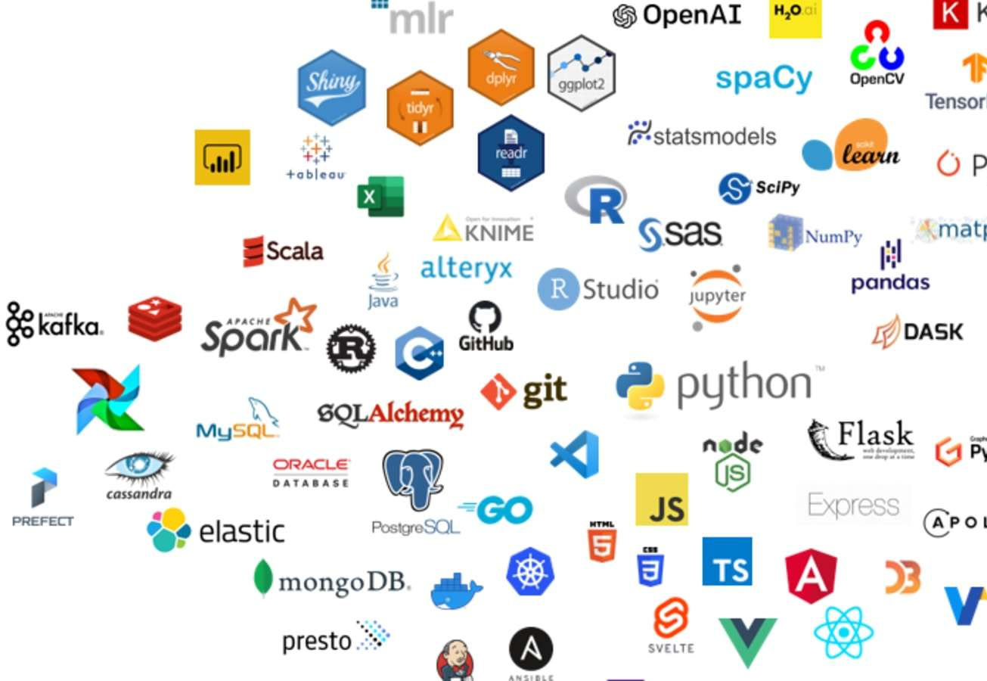
Tools and Technologies Used for this project
Programming & Data Analysis: Python, Jupyter Notebook, Pandas, NumPy, Scikit-learn, TensorFlow
Visualization & Reporting: Power BI, Matplotlib, Seaborn, Plotly, Excel
Web Development: HTML, CSS, JavaScript, PHP, Bootstrap, XML
Design & Planning: Figma, Draw.io, Microsoft Project, Microsoft Word, PowerPoint
Database & Hosting: MySQL, Apache Server, Cloud Deployment Platforms

Slide 9

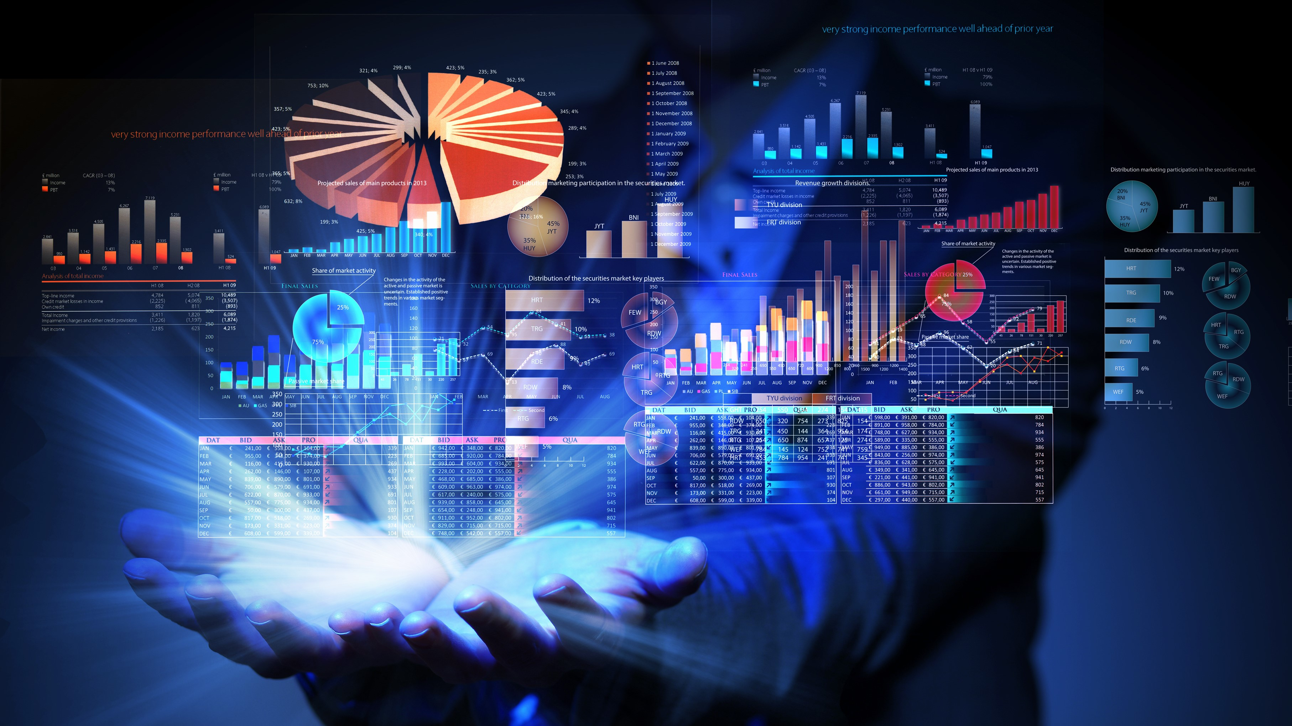
Process Planning
Defined project phases including requirement analysis, design, development, implementation, and testing using Agile methodology.
Created schedules with tools like Gantt charts and task sheets to allocate time, resources, and responsibilities effectively.
Ensured iterative progress through regular reviews, stakeholder meetings, and updates to adapt to evolving project needs.

Slide 10
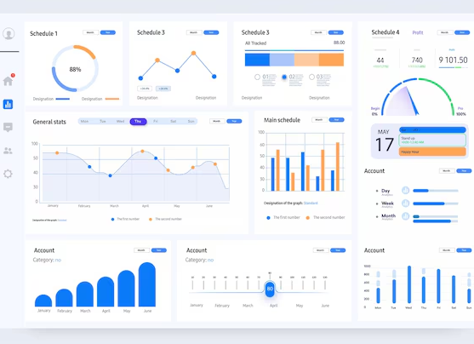
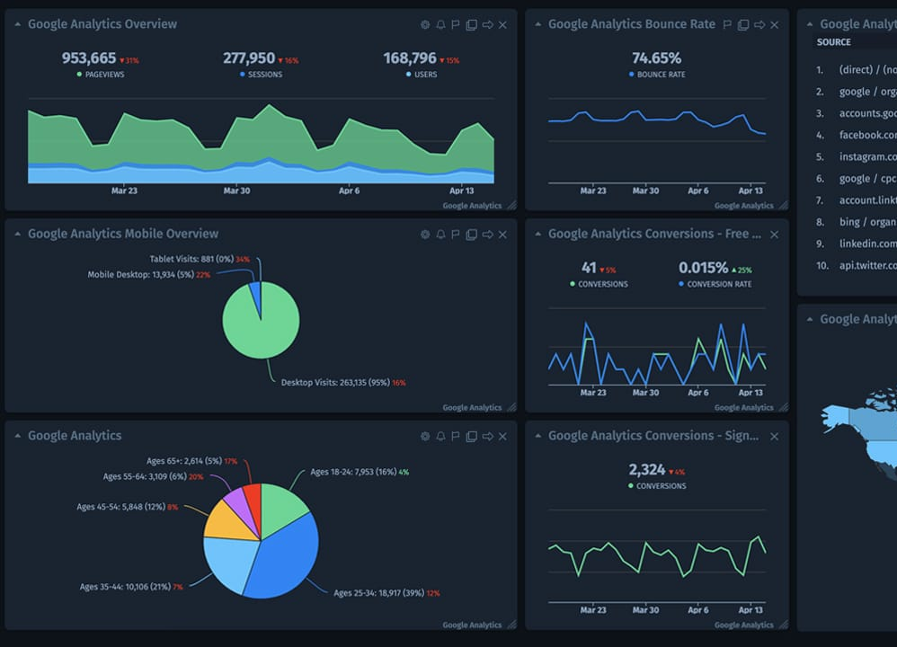
Dashboard Features
Interactive Visualizations: Dynamic charts, graphs, and filters allow users to explore healthcare data in real time with ease.
Predictive Analytics Display: Shows forecasts for patient trends, resource needs, and market patterns using integrated machine learning models.
Customizable Reports: Users can generate, download, and share tailored reports based on selected metrics and timeframes.
Real-Time Data Updates: Automatically refreshes with the latest data from integrated sources, ensuring decisions are based on current information.

Slide 11
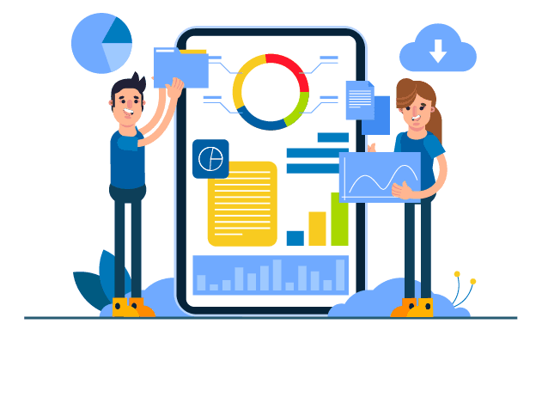
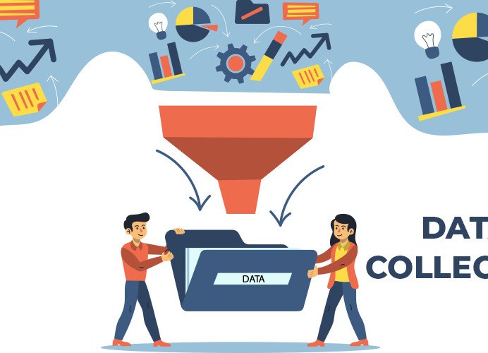
Data Collection Methods
Public Healthcare Databases: Retrieved datasets from trusted sources like WHO, government health portals, and open data platforms.
APIs & Web Scraping: Used APIs and Python-based web scraping techniques to gather real-time healthcare data from relevant websites.
Surveys & Feedback Forms: Collected qualitative data through digital surveys and forms targeted at healthcare professionals and patients.
Hospital System Integration: Incorporated data from hospital databases (e.g., patient records, appointment logs) through secure connections.

Slide 12
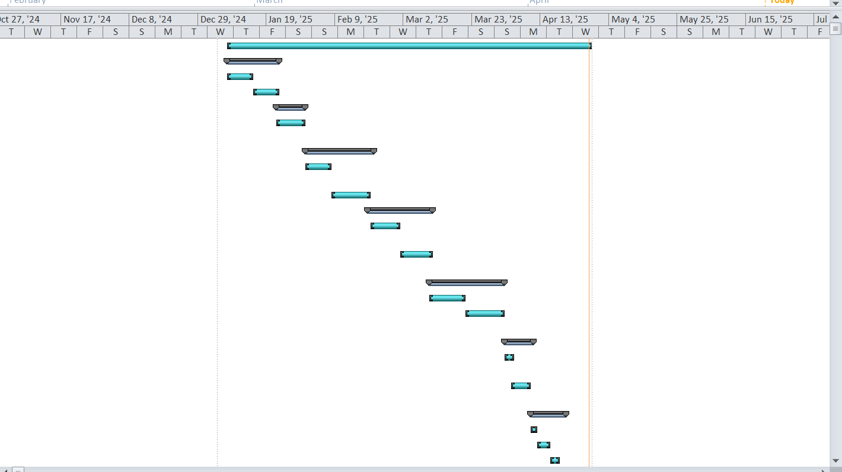
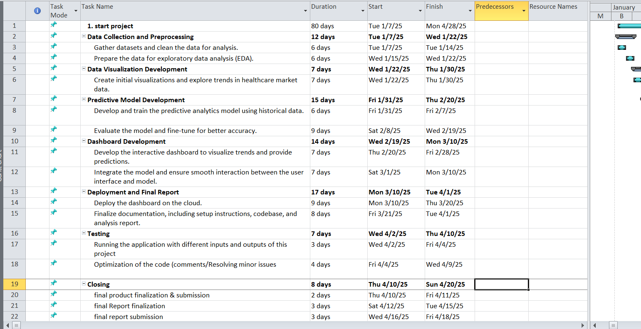
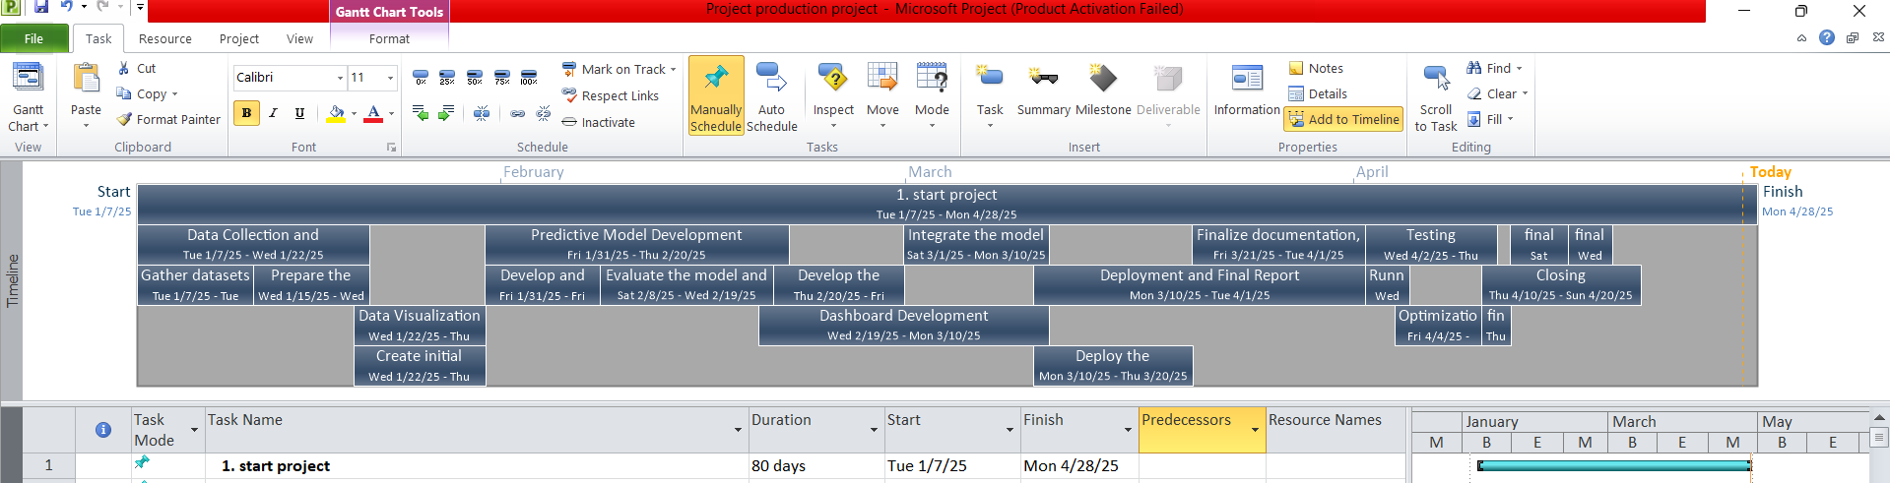
Gantt Chart
Tasksheet
Timeline

Slide 13
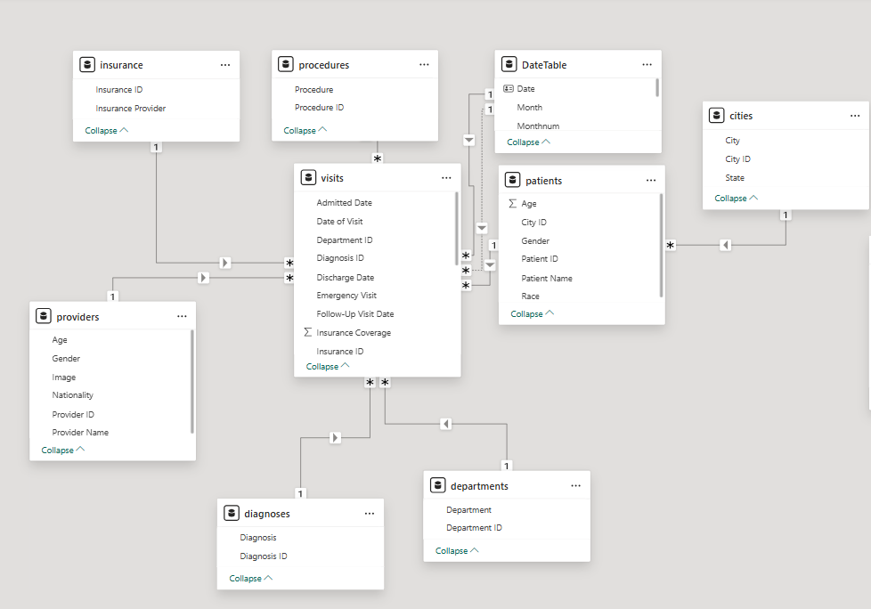
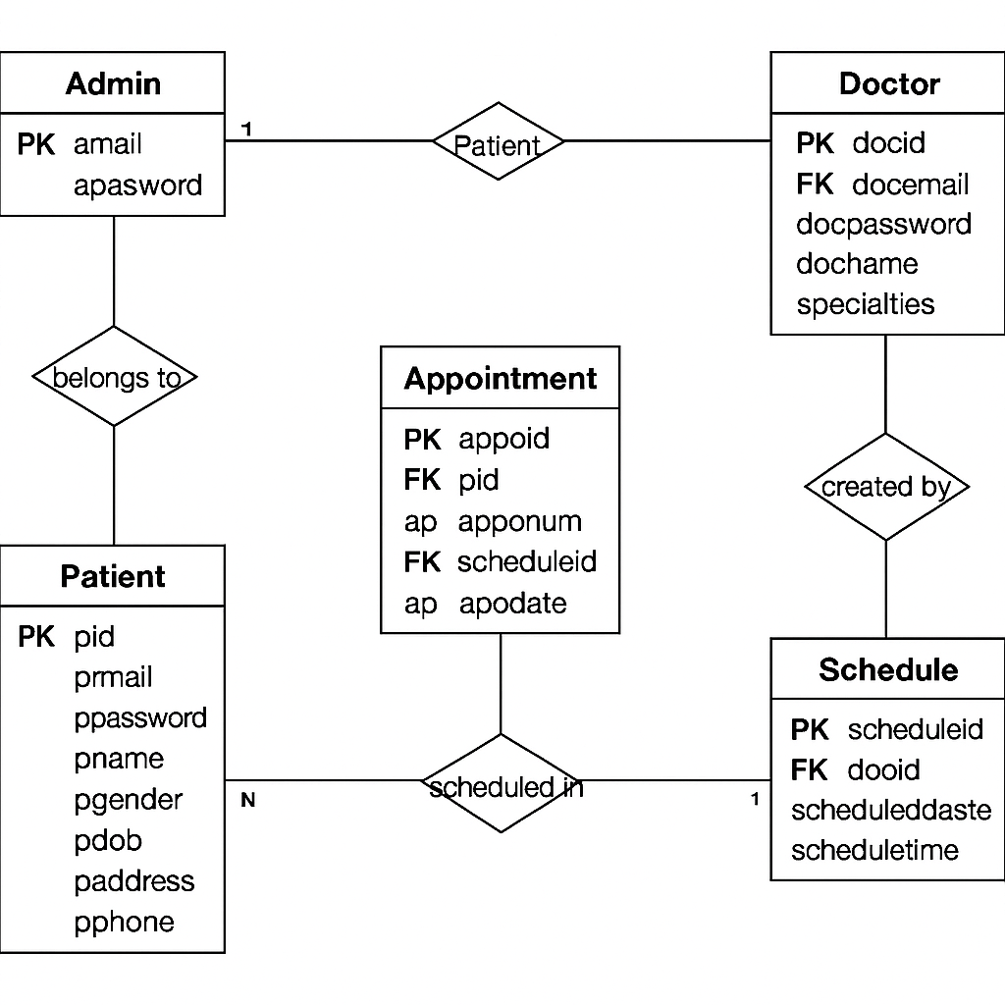
ERD Of the healthcare system's Erd diagram
ERD Of the Web application system's Erd diagram

Slide 14
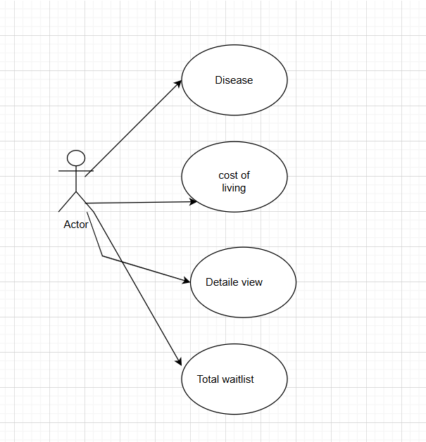
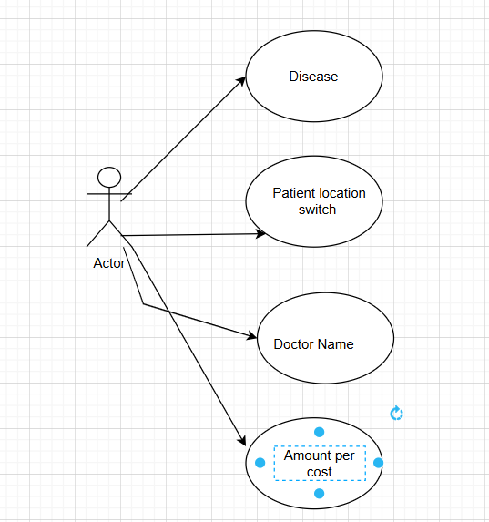
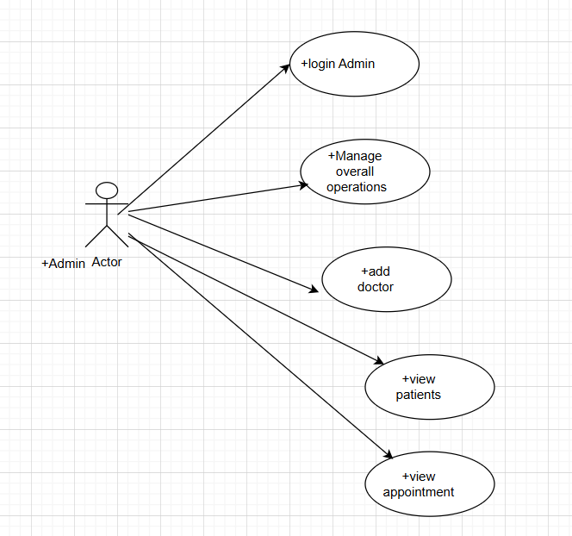
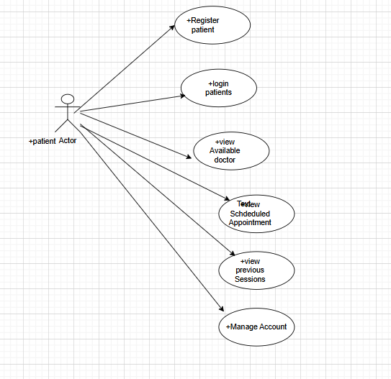
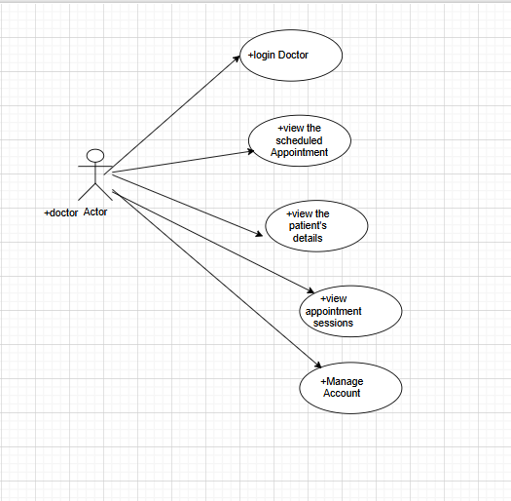
Use Case Diagram
A case diagram for a healthcare dashboard
Use Case Diagram for a Hospital Dashboard
The use case diagram for the administrator
The use case diagram for the patient
The use case diagram for the doctor

Slide 15
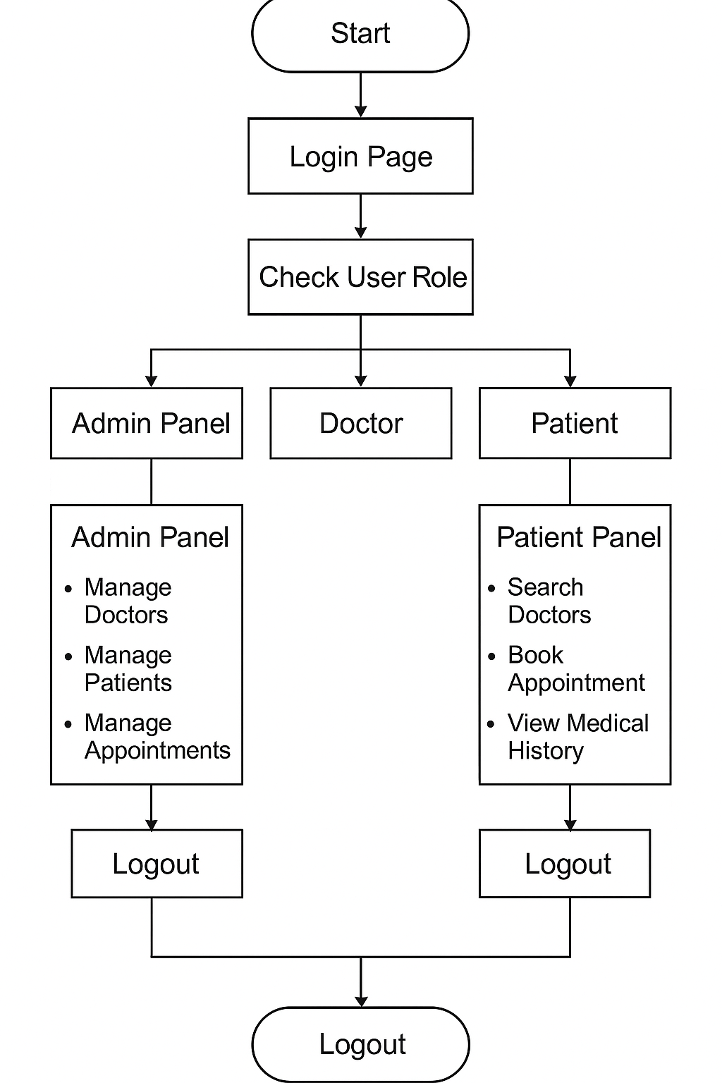
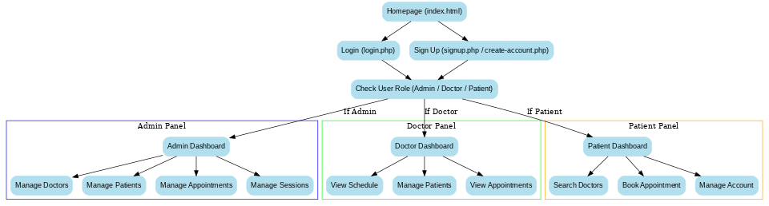
Control Flow Diagram
The Flowchart for Healthcare
The flowchart of the web application

Slide 16
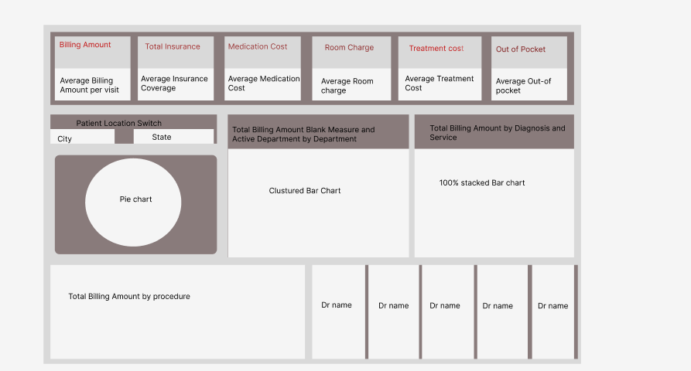
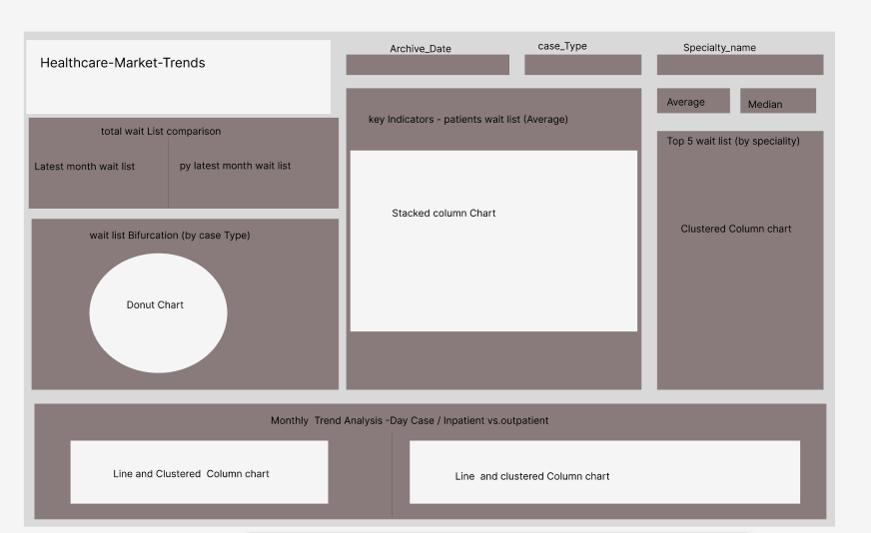
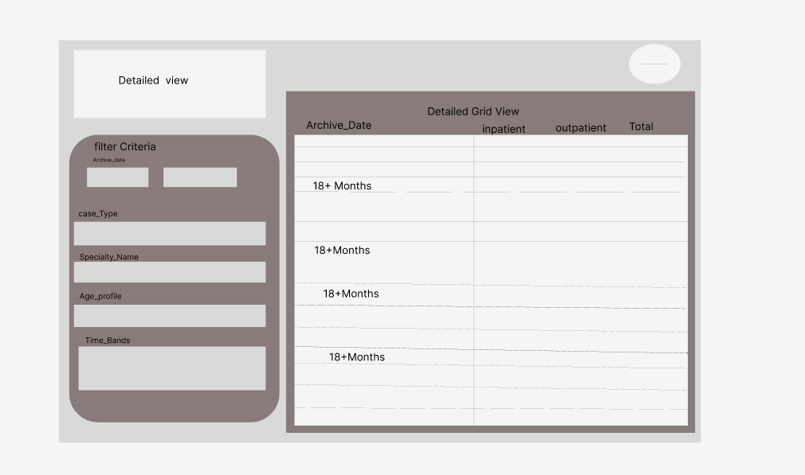
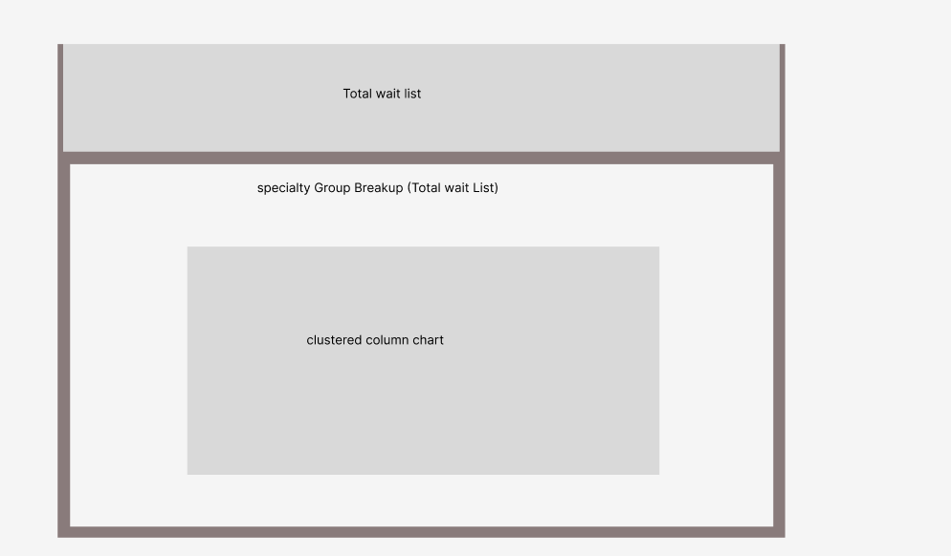
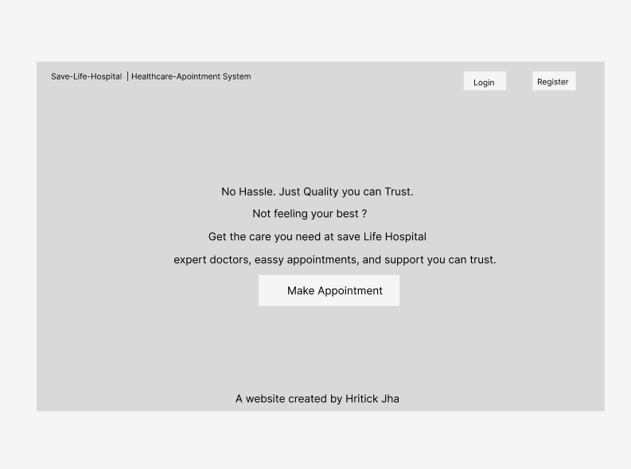
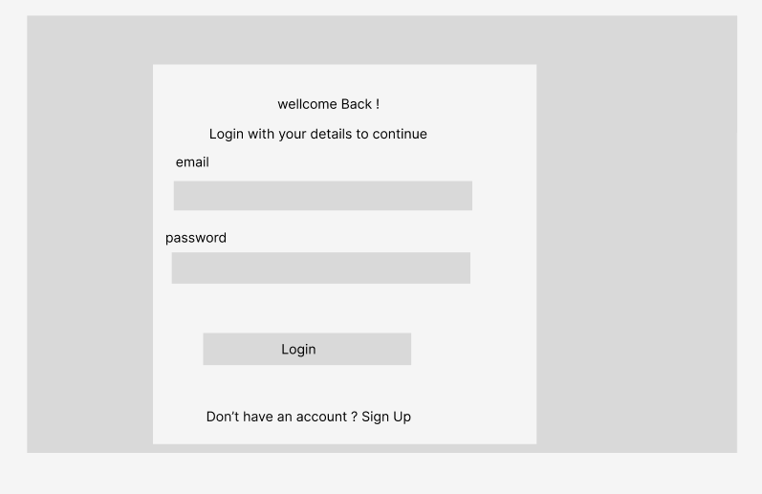
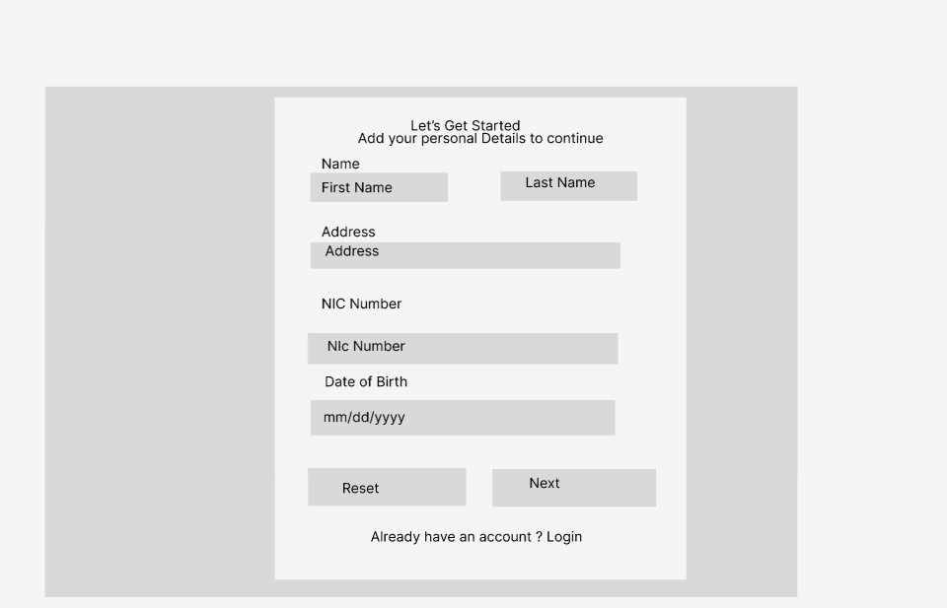
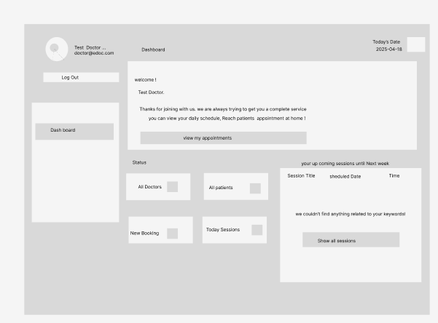
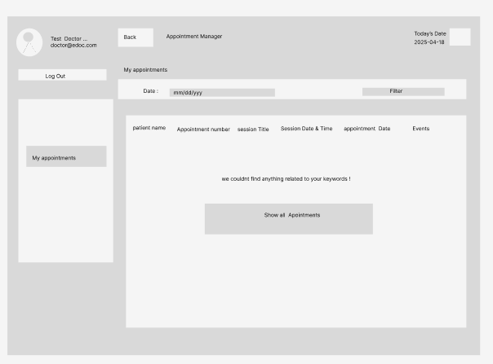
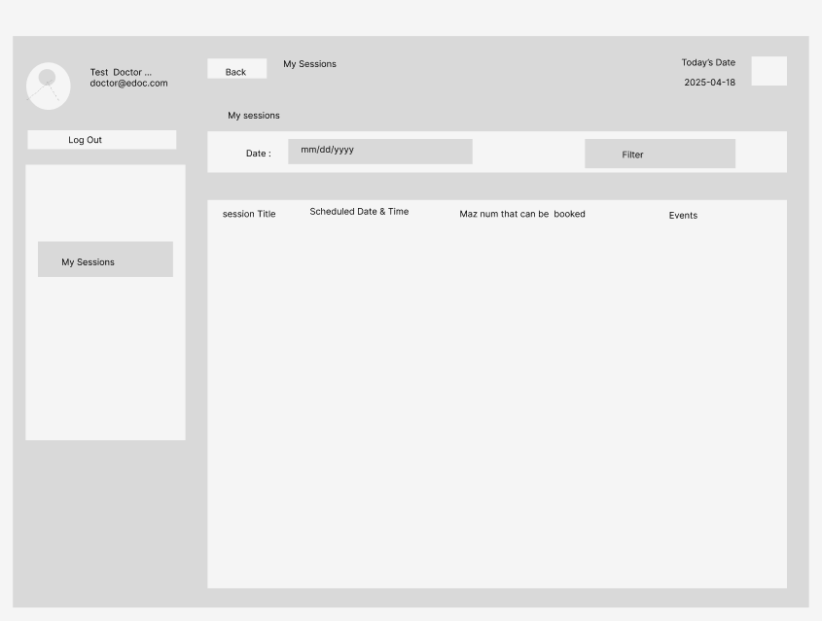
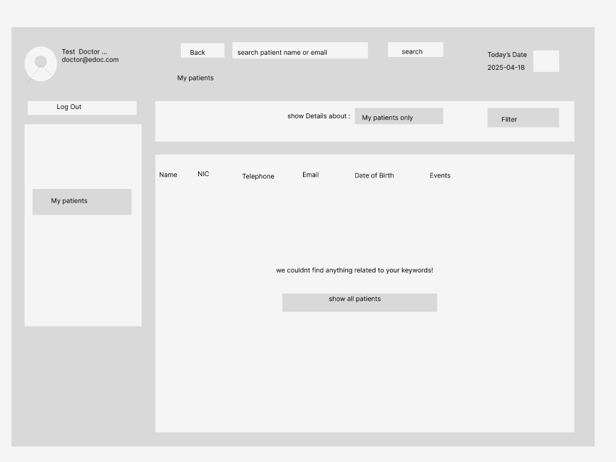
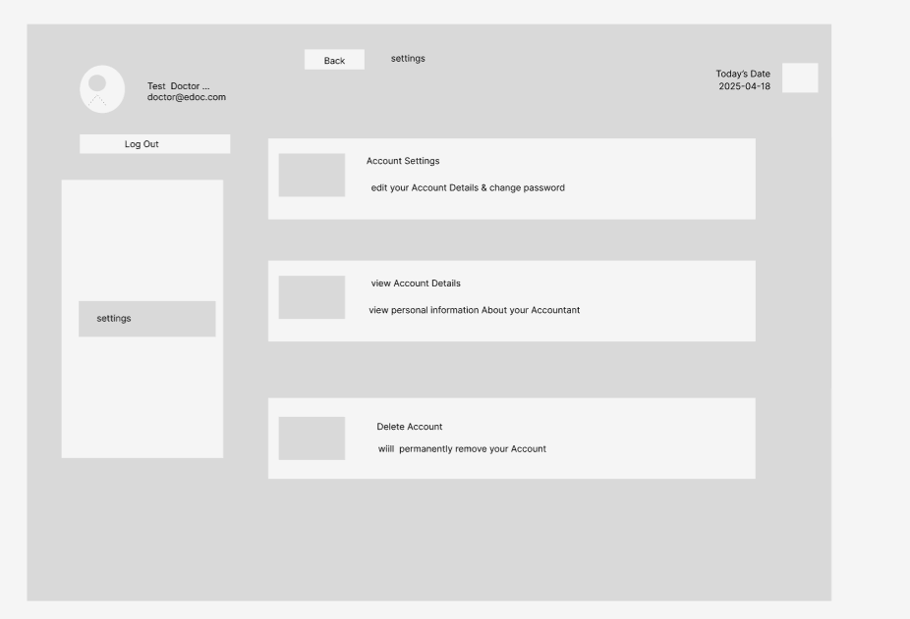
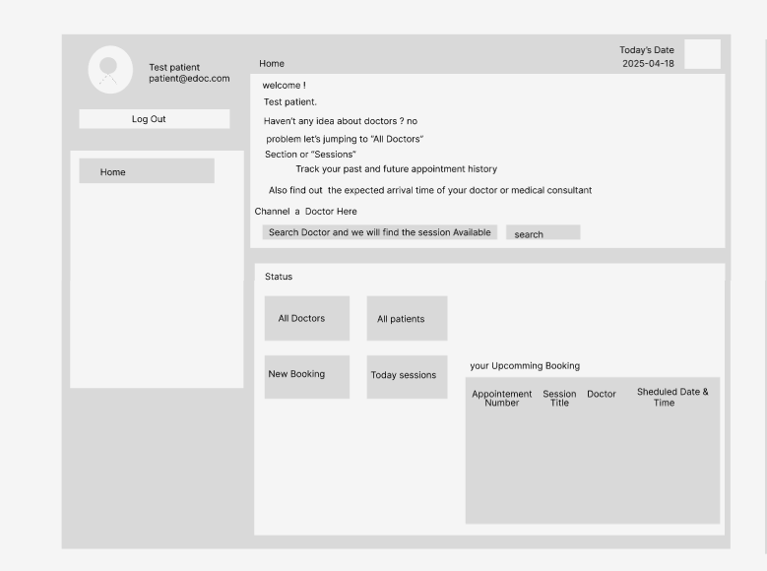
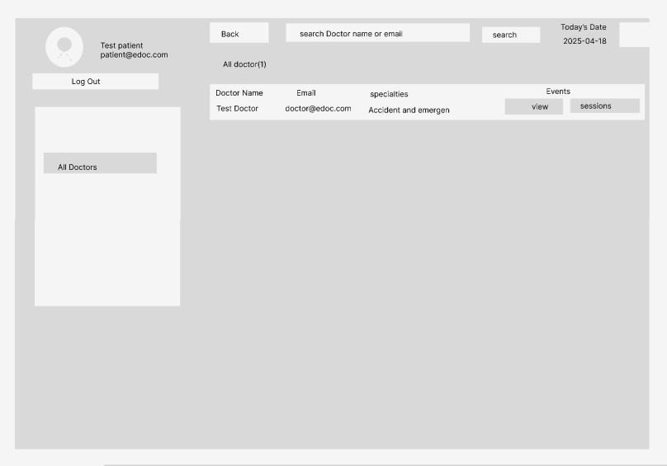
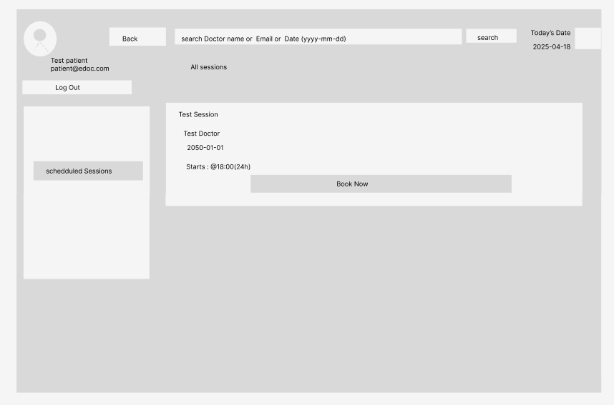
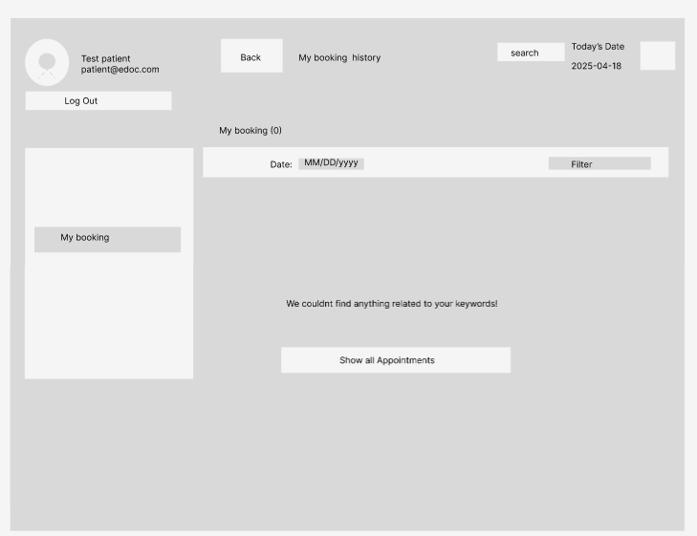
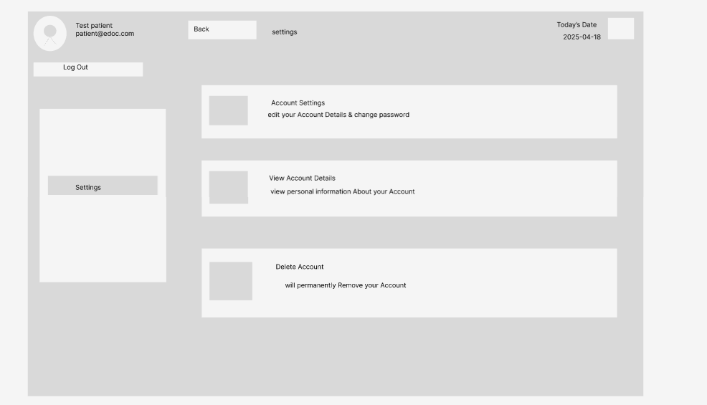
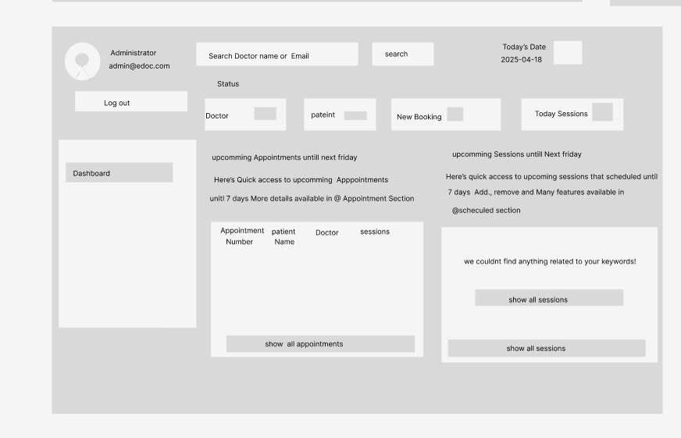
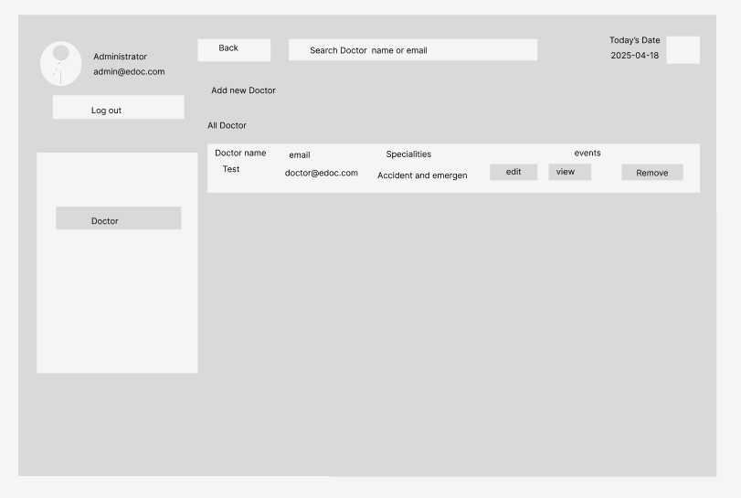
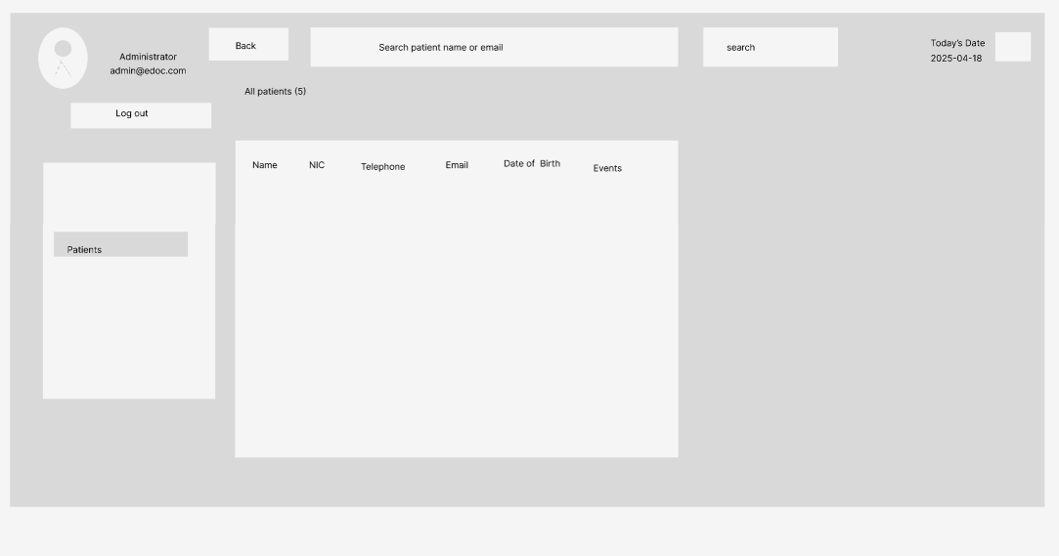
Wireframe Design

Slide 17

Product Benefits
Improved Decision-Making: Provides real-time, data-driven insights that support strategic planning and operational efficiency in healthcare.
Enhanced Resource Allocation: Helps healthcare providers optimize staffing, equipment, and budget based on predictive analytics.
User-Friendly Visualization: Interactive dashboards make complex data easily understandable for both technical and non-technical users.
Scalable & Secure Platform: Cloud-based deployment ensures the solution is scalable across facilities while maintaining high security standards.

Slide 18
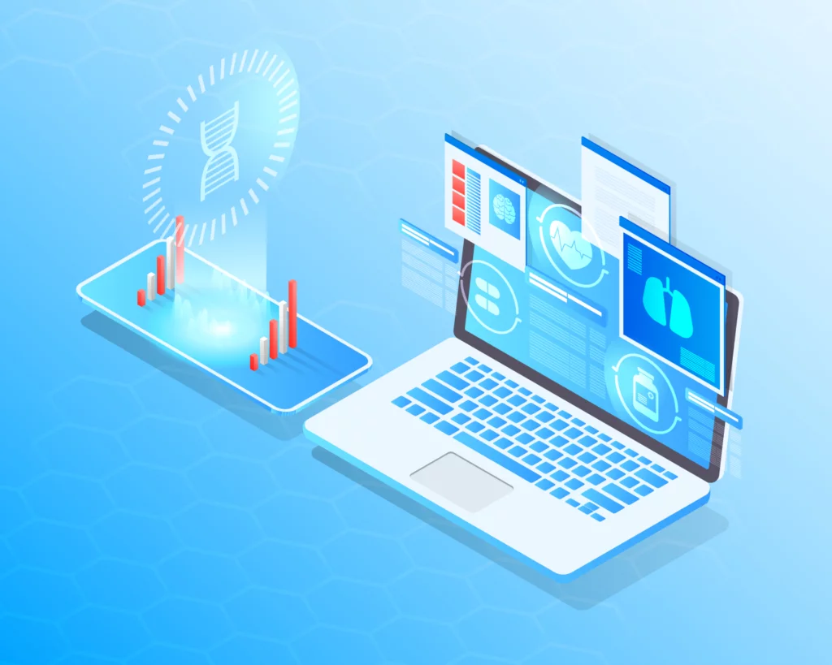
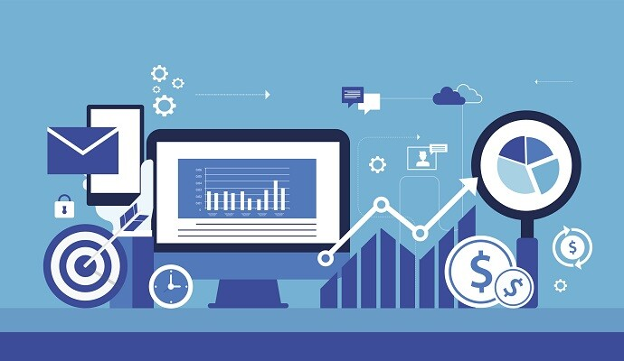
Future Research Opportunities
AI-Powered Diagnostics: Explore the use of advanced AI algorithms for more accurate diagnosis predictions and treatment recommendations.
Integration of Wearable Device Data: Incorporate real-time data from health trackers and IoT devices to improve personalized healthcare insights.
Cross-Regional Data Analysis: Expand the research to include diverse geographic regions for broader, more inclusive healthcare trend forecasting.
Natural Language Processing (NLP): Use NLP to analyze unstructured clinical notes and patient feedback for deeper healthcare analytics.

Slide 19
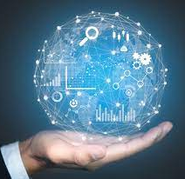
Future Product Enhancements
Mobile App Integration: Develop a companion mobile app to increase accessibility and allow real-time monitoring on the go.
Multilingual Support: Add support for multiple languages to make the platform usable by a more diverse user base.
AI-Driven Recommendations: Integrate advanced AI to provide automated insights, alerts, and decision suggestions for healthcare management.
Third-Party System Integration: Enable seamless integration with hospital management systems, EHRs, and other third-party healthcare tools.

Slide 20


Security Features
Data Encryption: All sensitive healthcare data is encrypted during storage and transmission to prevent unauthorized access.
Role-Based Access Control (RBAC): Access to the system is restricted based on user roles, ensuring only authorized personnel can view or modify specific data.
Regular Security Audits: Periodic system audits and vulnerability assessments are conducted to identify and fix potential security risks.
Compliance with Healthcare Standards: The system is designed to align with data protection regulations like HIPAA and GDPR to ensure legal and ethical data handling.

Slide 21

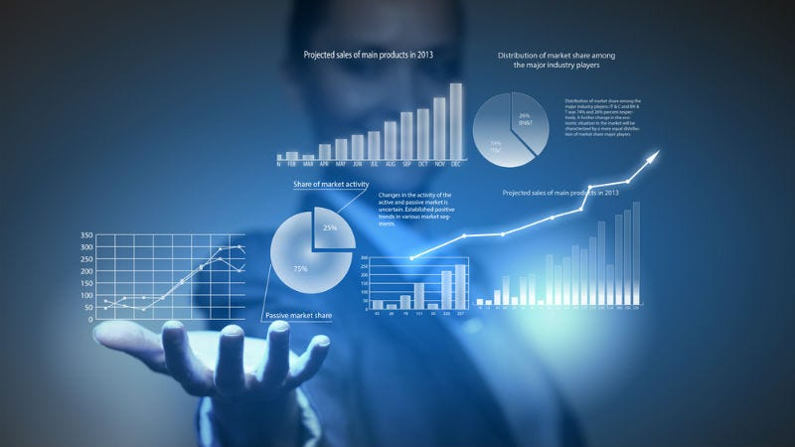
Results & Outcomes of the project
Developed a functional web application with real-time healthcare appointment booking and interactive dashboards.
Successfully implemented predictive analytics to identify healthcare trends and support strategic planning.
Enhanced decision-making through secure, user-friendly visualizations and cloud-based data accessibility.

Slide 22


Challenges Of the Product Development
Data Integration Complexity: Integrating multiple healthcare data sources with varying formats and standards posed technical difficulties during development.
Ensuring Real-Time Performance: Maintaining smooth and responsive real-time data updates on the dashboard required careful optimization and testing.
User Interface Design: Designing an intuitive, user-friendly dashboard that met both technical and non-technical user needs was challenging.
Security & Compliance: Implementing robust data security while ensuring compliance with healthcare data regulations (e.g., HIPAA/GDPR) was a critical concern.

Slide 23

User Feedback & Refinement
Initial User Testing: Early users, including healthcare staff and analysts, tested the dashboard and provided usability feedback.
Interface Enhancements: Based on feedback, UI elements were refined—such as improving navigation, simplifying filters, and adjusting color schemes for clarity.
Performance Improvements: Load times and responsiveness were optimized after identifying lag issues during user interaction.
Feature Adjustments: New features like customizable reports and export options were added based on user requests for flexibility and practicality.

Slide 24
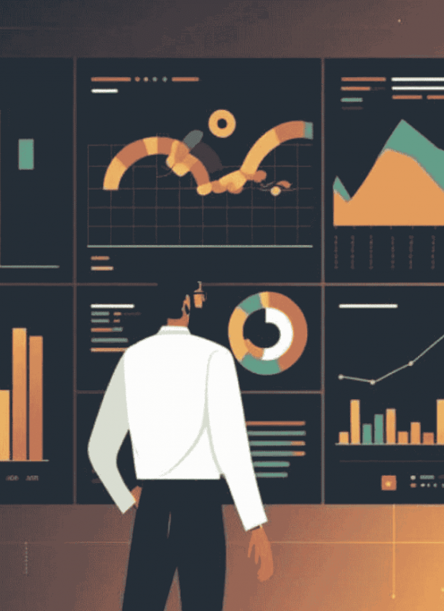
Conclusion & Future Scope
Conclusion: The project successfully applied data science tools to improve healthcare insights, resource allocation, and service efficiency.
Impact: Developed a reliable, scalable system combining predictive models and interactive dashboards for real-time decision-making.
Future Scope: Plans include expanding mobile accessibility, integrating multilingual support, and enhancing real-time data analysis with advanced AI models.

Slide 25
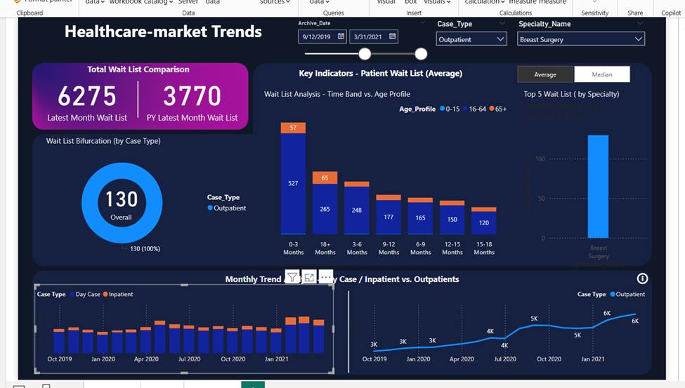
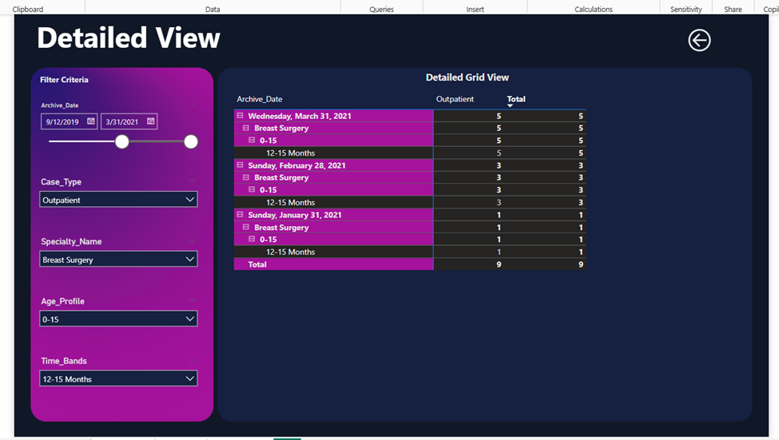
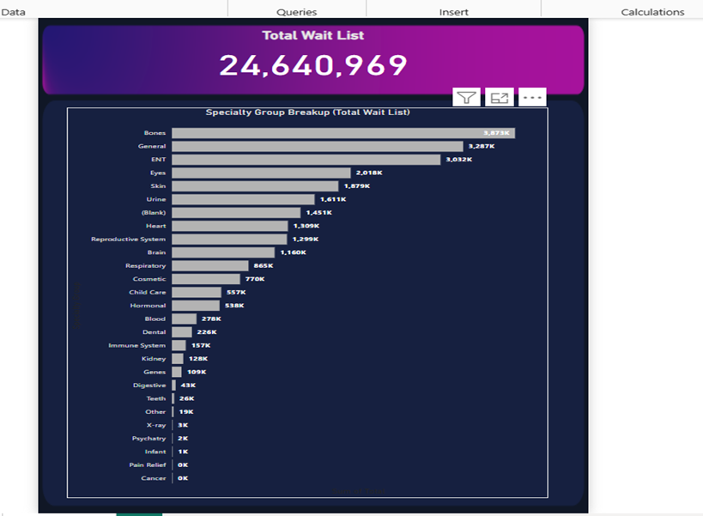

The full dashboard's second page shows the healthcare market trends unique to the ailment.
The main page and welcome page for the healthcare market trends and sickness dashboard
The dashboard's third page shows the entire wait list for healthcare market developments.
The page and welcoming space for the healthcare industry's developments and documentation.

Slide 26




The web application Trends in the healthcare market's home page or welcome page
Login page
Sign up page
Home page for patients

Slide 27




Doctor list displayed in patient page
Scheduled Sessions page for the patient
Appointment booking section for the patient
Setting options for the patient

Slide 28




Patients page to edit the information
Patients page to view the information
Patients’ option to delete the account
Doctor home page to view

Slide 29




Appointment page for doctor
Scheduled session page for doctors
Account setting page for the doctor
Patients’ history page for doctor

Slide 30




Home page for admin
Doctor details page for admin
Schedule manager page for admin
Appointment management page for the admin

Slide 31


Patient details page for admin
View page of the activities for the admin

Slide 32

Thank You
Any Questions ?

